Slide 1

NEVER OFF TRACK
Tools to Maintain Compliance Every Day
A practical guide to daily compliance requirements for financial advisors, covering practice setup, documentation standards, and client recordkeeping best practices.

Slide 2



SETTING UP YOUR PRACTICE
All documents below are non-client facing and are required in order to maintain a compliant practice.
Required Policies
Essential Files
Compliance Requirements
Privacy Breach Policy & Procedures
Complaint File
CE Credits
E&O
AMl / ATF Policy & Procedure Business Continuity Agreement
FTC (Fair Treatment of Consumers)
CARTE Advantage Code of Conduct
Cybersecurity Requirements
Considerations: Ensure all documents are up-to-date and readily accessible for regulatory reviews.

Slide 3
NEW ACCOUNT OPENING REQUIREMENTS
All documents below are client facing and need to be completed and placed into the client file, every time a NEW Account is set up.
These requirements ensure proper documentation and disclosure for all new client accounts, providing protection for both clients and advisors.

Slide 4
LIFE/CI/DI INSURANCE SALE REQUIREMENTS
Required Documents
Considerations
Advisor Disclosure Document
Fact Finder
Needs analysis
Types of Insurance
Illustration
LIRD (when applicable)
Reason Why Letter
These documents must be completed for every life, critical illness, or disability insurance sale to ensure compliance with regulatory requirements and to document the client's needs and the advisor's recommendations.

Slide 5
SEGREGATED FUND/GIC/ANNUITY SALE REQUIREMENTS
Required Documents
Considerations
Advisor Disclosure Document
Fact Finder
Segregated Fund Fee Disclosure
Questionnaire
Information Folder
Leverage Loan Documents
Fund Facts
Copy of Investment Application
Reason Why Letter

Slide 6
Complete client File for Segregated Funds
NAAF (includes the Trusted Contact Person), if you don't do a NAAF, please include the Trusted Contact Person
Investor Questionnaire
Advisor Disclosure
Privacy Consent
CASL
Reason Why Letter For Segregated Funds
Evidence that the client received the Fund Fact
Advisor Notes

Slide 7
Complete client File for Segregated Funds (Leveraged)
NAAF (includes the Trusted Contact Person), if you don't do a NAAF, please include the Trusted Contact Person
Investor Questionnaire
Advisor Disclosure
Privacy Consent
CASL
Reason Why Letter For Segregated Funds
Evidence that the client received the Fund Fact
Loan Assessment Suitability
Leverage Disclosure
Advisor Notes

Slide 8
Complete client File for Insurance Application
Needs Analysis
Investor Questionnaire
Advisor Disclosure
Privacy Consent
CASL
Reason Why Letter For Segregated Funds
Trusted Contact Person
Life Insurance Replacement (LIRD) if you are replacing an existing policy
Advisor Notes

Slide 9




SUPPLEMENTARY CLIENT FILE DOCUMENTS
All documents below are client facing and only need to be completed once per client file.
PRIVACY CONSENT
Client Signature Required
ANTISPAM C.A.S.L
Client Signature Required
LETTER OF ENGAGEMENT
Client Signature Required
TRUSTED CONTACT PERSON (TCP)
Client Signature Required
These supplementary documents establish the client-advisor relationship and ensure proper permissions are in place for communication and information sharing.

Slide 10
DOCUMENT MANAGEMENT BEST PRACTICES
Physical Documents
Digital Documents
Store in secure, locked filing cabinets
Use secure, encrypted storage systems
Organize by client name and document type
Implement consistent naming conventions
Maintain separate sections for required vs. consideration documents
Back up all files regularly
Ensure password protection and access controls
Regularly audit files for completeness
Proper document management is essential for maintaining compliance and ensuring quick access to required documentation during regulatory reviews or client inquiries.

Slide 11
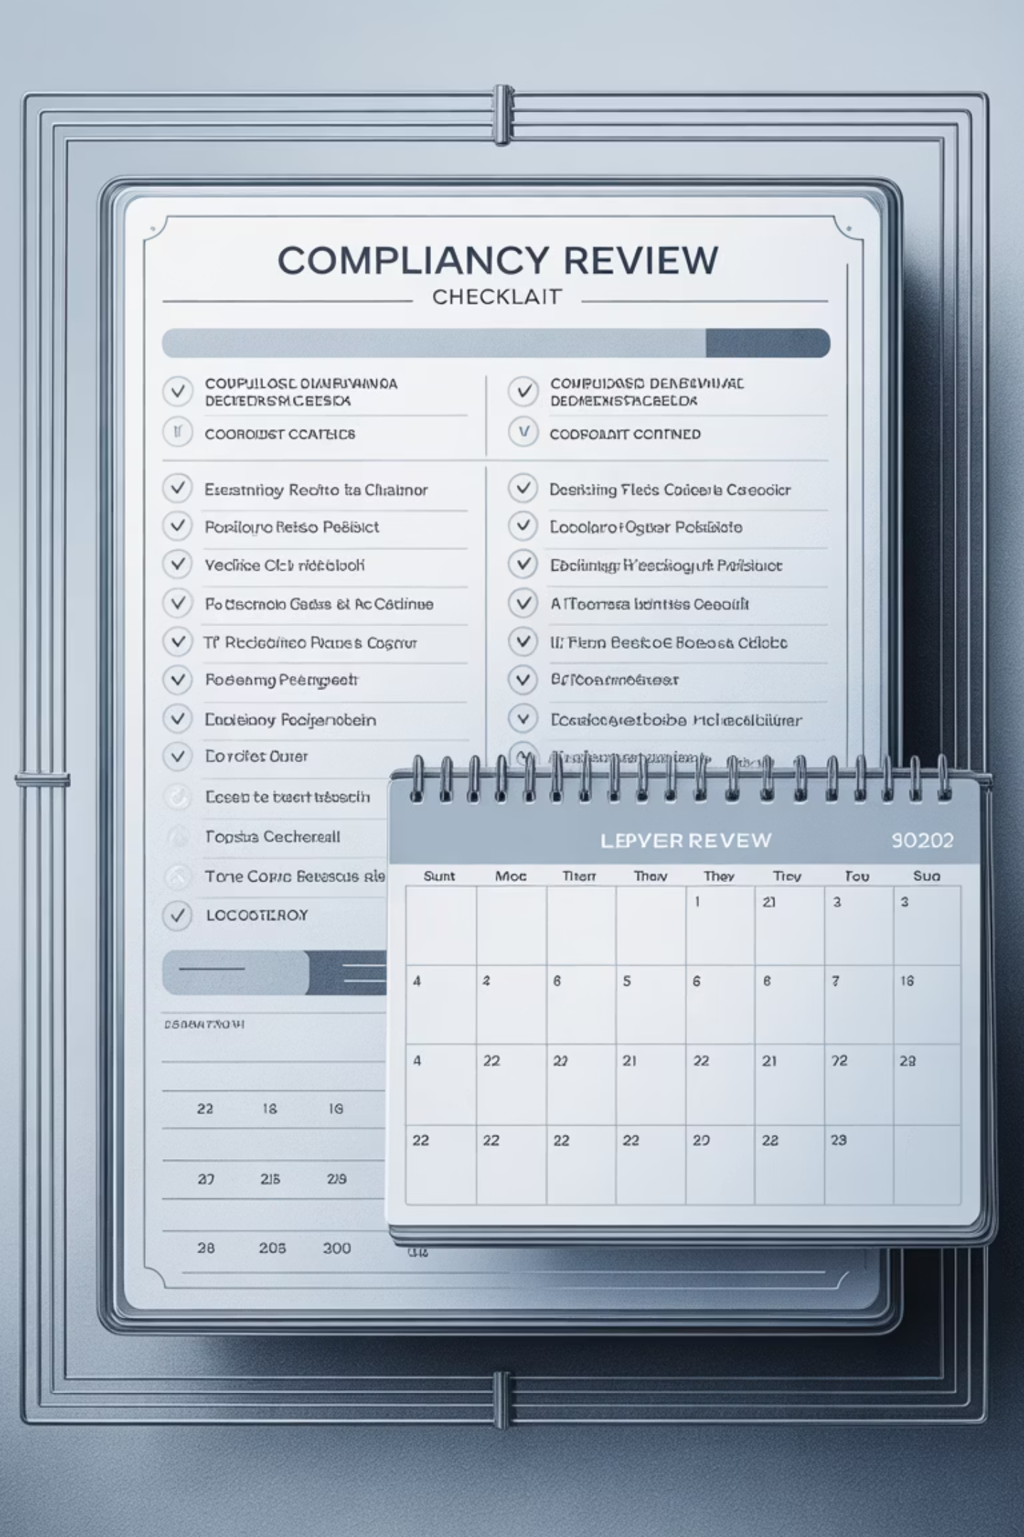
COMPLIANCE REVIEW CHECKLIST
Daily Compliance Tasks
Review all new client documentation for completeness and signatures before filing. Ensure all required disclosures have been provided to clients.
Monthly Compliance Tasks
Audit a sample of client files to ensure all required documents are present and properly completed. Update any policies or procedures that have changed.
Annual Compliance Tasks
Complete full review of all practice policies and procedures. Renew E&O insurance and update CE credits. Conduct comprehensive client file audit.
Regular compliance reviews help identify and address potential issues before they become regulatory concerns. By maintaining a consistent review schedule, you can ensure your practice remains "Never Off Track" with compliance requirements.

Slide 12

Compliance Links
To help you maintain compliance throughout this period, please make sure that each client file is complete and follows compliance guidelines. I encourage you to utilize the following resources:
Segregated Funds Compliance Documents: https://carte.easysend.app/client-onb-compliance-docs
Life Insurance Needs Analysis:
https://carte.easysend.app/life-carte
Disability Needs Analysis: https://carte.easysend.app/disability-insurance
Critical Illness Needs Analysis: https://carte.easysend.app/needs-analysis-critical-illness

Slide 13

Q&A

Slide 14

Thank you for taking the time to attend this compliance session.
This session was designed to provide essential tools and practical guidance to support your continued success, with a focus on daily compliance requirements. We hope you found the overview helpful, including key elements around practice setup, new account and insurance documentation, and supplementary client recordkeeping.
Your commitment to maintaining a compliant and client-focused practice is truly appreciated, and we are here to support you every step of the way.

